Slide 1
chapter 4
Paradigms
(additional materials)

Slide 2
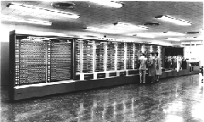
Beginnings – Computing in 1945
Harvard Mark I
  Picture from http://piano.dsi.uminho.pt/museuv/indexmark.htm
55 feet long, 8 feet high, 5 tons
Notes:
Picture from http://piano.dsi.uminho.pt/museuv/indexmark.htm

Slide 3
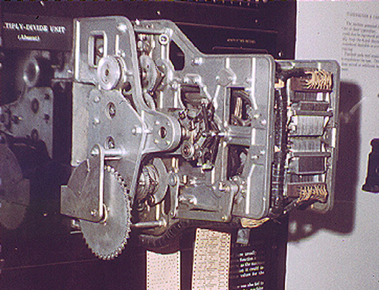
Context - Computing in 1945
Ballistics calculations
Physical switches (before microprocessor)
Paper tape
Simple arithmetic & fixed calculations (before programs)
3 seconds to multiply
Picture from http://www.gmcc.ab.ca/~supy/
Notes:
Picture from http://www.gmcc.ab.ca/~supy/

Slide 4
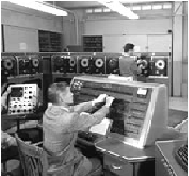
Batch Processing
Computer had one task, performed sequentially
No “interaction” between operator and computer after starting the run
Punch cards, tapes for input
Serial operations

Slide 5
People
Who are the people associated with various interactive paradigm shifts?

Slide 6

Other Resources
Howard Rheingold – Tools for Thought
  History of interactive breakthroughs
  On-line at http://www.rheingold.com/texts/tft/

Slide 7
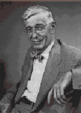
Innovator: Vannevar Bush
“As We May Think” - 1945 Atlantic Monthly
  “…publication has been extended far beyond our
  present ability to make real use of the record.”
Postulated Memex device
  Stores all records/articles/communications
  Items retrieved by indexing, keywords, cross
  references (now called hyperlinks)
  (Envisioned as microfilm, not computer)
Interactive and nonlinear components are key
http://www.theatlantic.com/unbound/flashbks/computer/bushf.htm

Slide 8
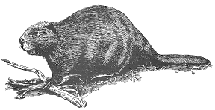
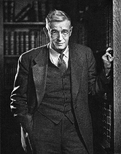
More About Vannevar Bush
Name rhymes with "Beaver"
Faculty member MIT
Coordinated WWII effort with 6000 US scientists
Social contract for science
  federal government funds universities
  universities do basic research
  research helps economy & national defense
Notes:
Picture of Bush from http://www-eecs.mit.edu/AY95-96/events/bush/

Slide 9
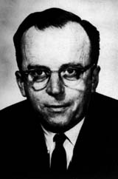
Innovator: J. R. Licklider
1960 - Postulated “man-computer symbiosis”
Couple human brains
and computing machines
tightly to revolutionize
information handling

Slide 10
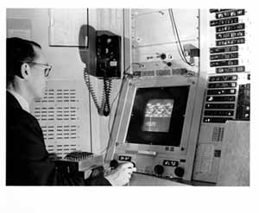
Innovator: Ivan Sutherland
SketchPad - 1963 PhD thesis at MIT
  Hierarchy - pictures & subpictures
  Master picture with instances (ie, OOP)
  Constraints
  Icons
  Copying
  Light pen input device
  Recursive operations

Slide 11
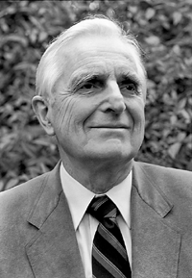
Innovator: Douglas Englebart
Landmark system/demo:
  hierarchical hypertext, multimedia, mouse, high-res display, windows, shared files, electronic messaging, CSCW, teleconferencing, ...
Inventor
of mouse

Slide 12

About Doug Engelbart
Graduate of Berkeley (EE '55)
  "bi-stable gaseous plasma digital devices"
Stanford Research Institute (SRI)
  Augmentation Research Center
1962 Paper "Conceptual Model for Augmenting Human Intellect"
  Complexity of problems increasing
  Need better ways of solving problems
Picture of Engelbart from bootstrap.org
Notes:
Picture of Engelbart from bootstrap.org

Slide 13
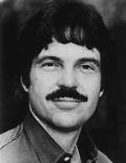
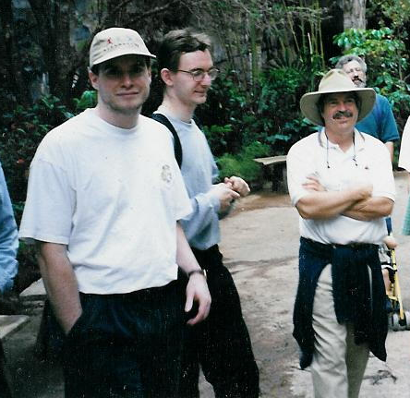
Innovator: Alan Kay
Dynabook - Notebook sized computer loaded with multimedia and can store everything
@PARC
Personal
computing
Desktop
interface
Overlapping
windows

Slide 14
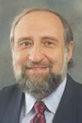
Innovator: Ben Shneiderman
Coins and explores notion of direct manipulation of interface
Long-time Director of
HCI Lab at Maryland

Slide 15
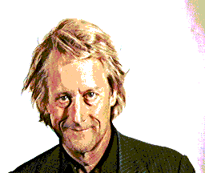
Innovator: Ted Nelson
Computers can help people, not just business
Coined term
“hypertext”

Slide 16
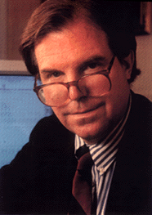
Innovator: Nicholas Negroponte
MIT Architecture Machine Group
  ’69-’80s - prior to Media Lab
Ideas
  wall-sized displays, video
  disks, AI in interfaces
  (agents), speech recognition,
  multimedia with hypertext
  Put That There (Video)

Slide 17
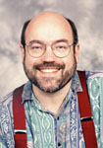
Innovator: Mark Weiser
Introduced notion of Ubiquitous Computing and Calm Technology
  It’s everywhere, but recedes quietly into background
CTO of Xerox PARC

